Slide 1
Charting Your Course to Optimal GPO and IDN Relationships
Begin

Slide 2
Objectives:
Upon completion of this section, you should be able to:
Understand the role of GPOs and IDNs in the contracting process
Understand Surgical Solutions process to obtain a GPO agreement
Be able to decipher a GPO agreement based on Quick Facts
Know where to locate GPO agreement information
Understand where to obtain GPO information about your accounts
Next

Slide 3
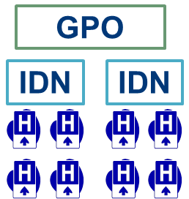
GPO
(Group Purchasing organization)
An organization created to help hospitals and other providers pool their purchasing power to secure significant discounts on virtually all medical and other hospital supplies.
IDN
(Integrated Delivery Network)
A network of facilities and providers working together to offer a continuum of care to a specific market or geographic area (also referred to IHN-integrated healthcare network).
Learn More about GPOS
Learn more about IDNs
Next

Slide 4
GPO (group Purchasing Organization)
A GPO negotiates pricing and contracts on behalf of its members with the objective of lowering overall costs.
Large IDNs and Systems are typically the owners of the GPOs
Hospitals pay the GPO an annual fee to negotiate on their behalf
Manufacturers pay the GPO a fee to market their agreements to the hospitals
GPO
As the GPO’s membership expands, its ability to leverage purchasing power decreases.
Return

Slide 5
IDN (Integrated Delivery Network)
Developed in the early 1980s, IDNs emerged to address common concerns like capitation, excess capacity, decreased margins, and complaints from patients regarding access
Includes many types of associations across the continuum of care and one network may include a short- and long-term hospital, HMO, PHO, PPO, home health agency, and hospice services.
Examples: Kaiser, Tenet, Partners Health System, IHC, UPMC, Northshore/LIJ Health System
Return

Slide 6
Did You know…
Today, virtually every hospital in the U.S. belongs to at least one GPO. More than 70% of all hospital purchases are made through GPO contracts, and GPOs contract for purchases with an annual value in the range of $150 billion.
Next

